Slide 1
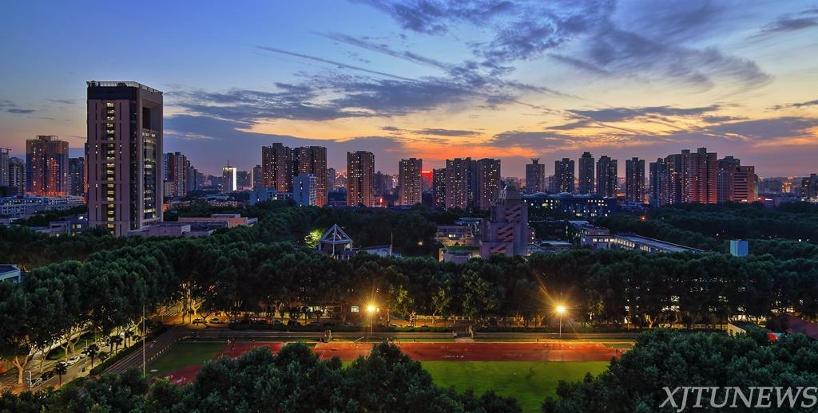
Training Networks in Null Space of Feature Covariance for Continual Learning
Shipeng Wang, Xiaorong Li, Jian Sun, Zongben Xu
Xi’an Jiaotong University
June 2021

Slide 2
PART 01
Background
Problem setting
Catastrophic forgetting
Existing strategies

Slide 3
Catastrophic forgetting
The phenomenon of forgetting
When training on sequential tasks,
☹️ catastrophic forgetting always happens, i.e., The performance on old tasks becomes worse.
Task 1
Task 2
Task 3
😀 The goal of Continual learning: keeping good performance on old tasks .
Desired performance

Slide 4
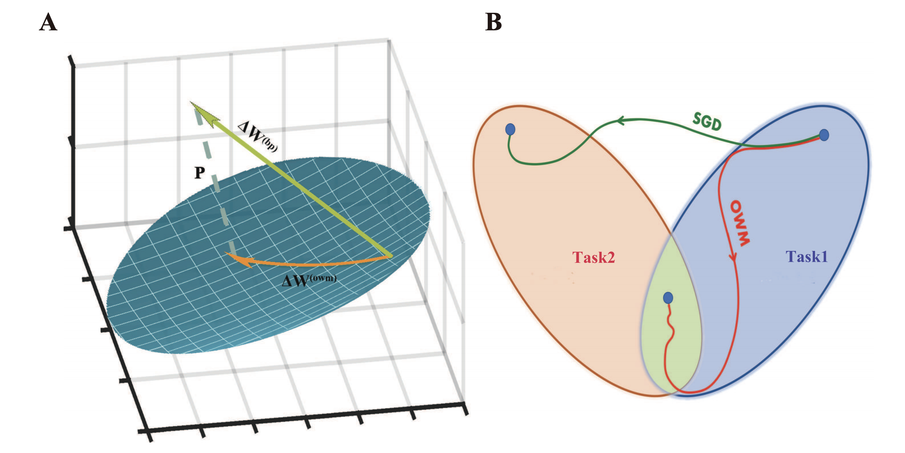
Catastrophic forgetting
Strategies for avoid forgetting:
Model-based | Regularized-based | EWC, MAS, SI, Rwalk, NPC
 | Distillation-based | LwF, LwM, GD-WILD
 | Architecture-based | PNN, HAT, CPG
Data-based | Replay-based | iCaRL, EEIL, BiC
Optimization-based | Algorithm-based | GEM, A-GEM, OWM
Algorithm-based strategies avoid forgetting by modifying the parameter update vector, such as OWM.

Slide 5
PART 02
Adam-NSCL
Motivation
Theorem
Algorithm

Slide 6
Overview
$$f(⋅,{\tilde{w}}_{1})$$
$$f(⋅,{\tilde{w}}_{2})$$
$$f(⋅,{\tilde{w}}_{3})$$
Data $X_{1}$
Data $X_{2}$
Data $X_{3}$
Without $X_{1}$
Without $X_{1}$, $X_{2}$
No forgetting if $f\left(X_{p},{\tilde{w}}_{t}\right)=f(X_{p}, {\tilde{w}}_{p})$ on data $X_{p}$ ($p<t$).
Our work:
proposes the sufficient condition for $f\left(X_{p},{\tilde{w}}_{t}\right)=f(X_{p}, {\tilde{w}}_{p})$;
put forward training algorithm for continual learning based on the condition.

Slide 7
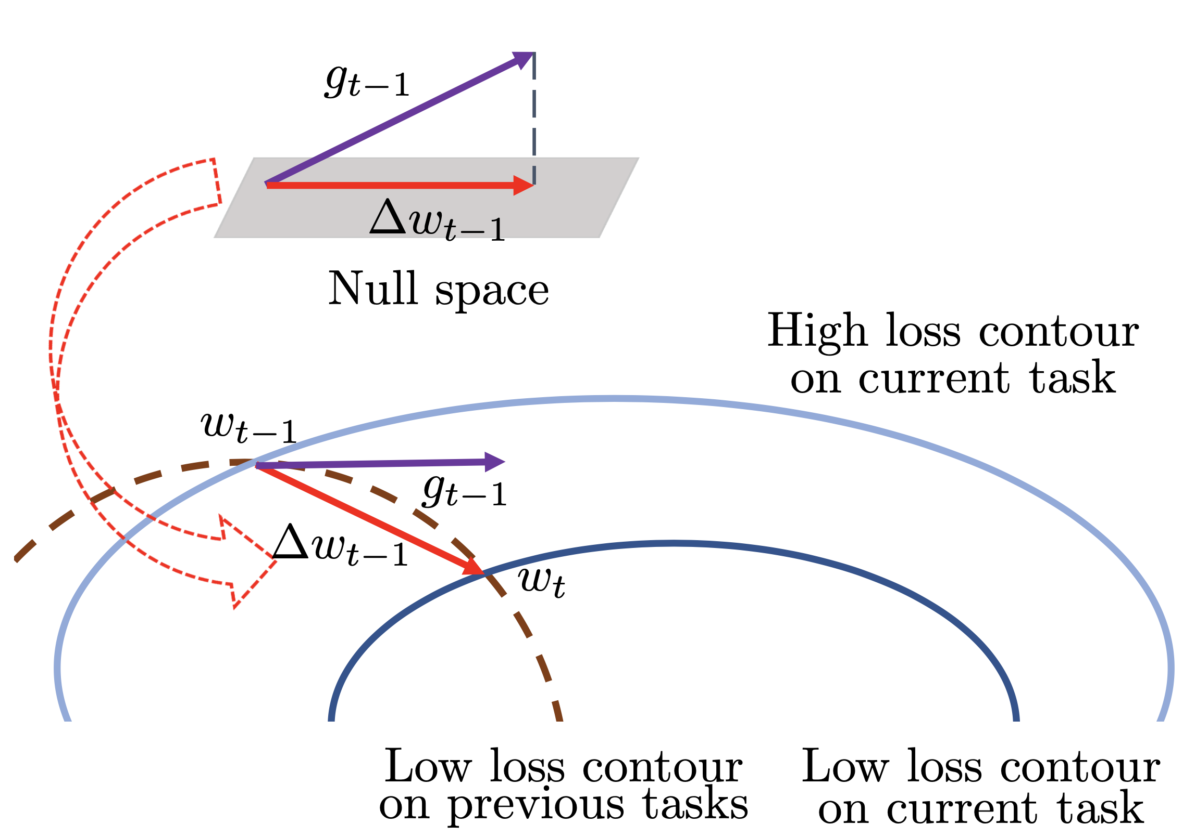
Motivation (toy example)
Considering training 1-layer fully connected network $f\left(x,w\right)=σ(xw)$ on two tasks sequentially.
$X_{t}$: | Data of task $𝒯_{t}$($t=1,2$)
${\tilde{w}}_{1}$: | Optimal param. on $𝒯_{1}$
$w_{2,s}$: | Param. at the $s$-th step when training on $𝒯_{2}$
$Δw_{2,s}$: | Update vector at the $s$-th step when training on $𝒯_{2}$
$𝒩\left(X\right)$: | Null space of $X$
If $Δw_{2,s}$ lies in $𝒩\left(X_{1}\right)$, i.e., $X_{1}$ $Δw_{2,s}$=0,
$$X_{1}w_{2,s}=X_{1}\left({\tilde{w}}_{1}+\sum_{s}{Δw_{2,s}}\right)=X_{1}{\tilde{w}}_{1}$$
$f\left(X_{1},w_{2,s} \right)=f\left(X_{1},{\tilde{w}}_{1}\right)$, i.e., NO FORGETTING

Slide 8
Motivation (toy example)
Considering training 1-layer fully connected network $f\left(x,w\right)=σ(xw)$ on two tasks sequentially.
$X_{t}$: | Data of task $𝒯_{t}$($t=1,2$)
${\tilde{w}}_{1}$: | Optimal param. on $𝒯_{1}$
$w_{2,s}$: | Param. at the $s$-th step when training on $𝒯_{2}$
$Δw_{2,s}$: | Update vector at the $s$-th step when training on $𝒯_{2}$
$𝒩\left(X\right)$: | Null space of $X$
If $Δw_{2,s}$ lies in $𝒩\left(X_{1}\right)$, i.e., $X_{1}$ $Δw_{2,s}$=0,
$$X_{1}w_{2,s}=X_{1}\left({\tilde{w}}_{1}+\sum_{s}{Δw_{2,s}}\right)=X_{1}{\tilde{w}}_{1}$$
☹️ It needs to preserve $X_{1}$ when training on $𝒯_{2}$, which is prohibited.
$f\left(X_{1},w_{2,s} \right)=f\left(X_{1},{\tilde{w}}_{1}\right)$, i.e., NO FORGETTING

Slide 9
Motivation (toy example)
Considering training 1-layer fully connected network $f\left(x,w\right)=σ(xw)$ on two tasks sequentially.
$X_{t}$: | Data of task $𝒯_{t}$($t=1,2$)
${\tilde{w}}_{1}$: | Optimal param. on $𝒯_{1}$
$w_{2,s}$: | Param. at the $s$-th step when training on $𝒯_{2}$
$Δw_{2,s}$: | Update vector at the $s$-th step when training on $𝒯_{2}$
$𝒩\left(X\right)$: | Null space of $X$
Since$𝒩\left(X_{1}^{⊤}X_{1}\right)$=$𝒩\left(X_{1}^{⊤}\right)$, if $Δw_{2,s}$ lies in $𝒩\left(X_{1}^{⊤}X_{1}\right)$,
Pros of$𝒩\left(X_{1}^{⊤}X_{1}\right)$:
😀 memory efficient
$X_{1}∈ ℝ^{n_{1}×s},X_{1}^{⊤}X_{1}$ $∈ ℝ^{s×s}$, $s≪n_{1}$
$s$: dim. of feature
$n_{1}$: num. of data
😀 covariance $X_{1}^{⊤}X_{1}$ can be incrementally
updated with the coming of tasks.
$$X_{1}w_{2,s}=X_{1}\left({\tilde{w}}_{1}+\sum_{s}{Δw_{2,s}}\right)=X_{1}{\tilde{w}}_{1}$$
$f\left(X_{1},w_{2,s} \right)=f\left(X_{1},{\tilde{w}}_{1}\right)$, i.e., NO FORGETTING

Slide 10
Theoretical condition for continual learning
For training $L$-layer fully connected network on multiple tasks sequentially
is the concatenation of input feature of $l$-layer on data from previous tasks

Slide 11
Theoretical condition for continual learning
For training $L$-layer fully connected network on multiple tasks sequentially
is the concatenation of input feature of $l$-layer on data from previous tasks
No need to store data/feature from previous tasks.

Slide 12
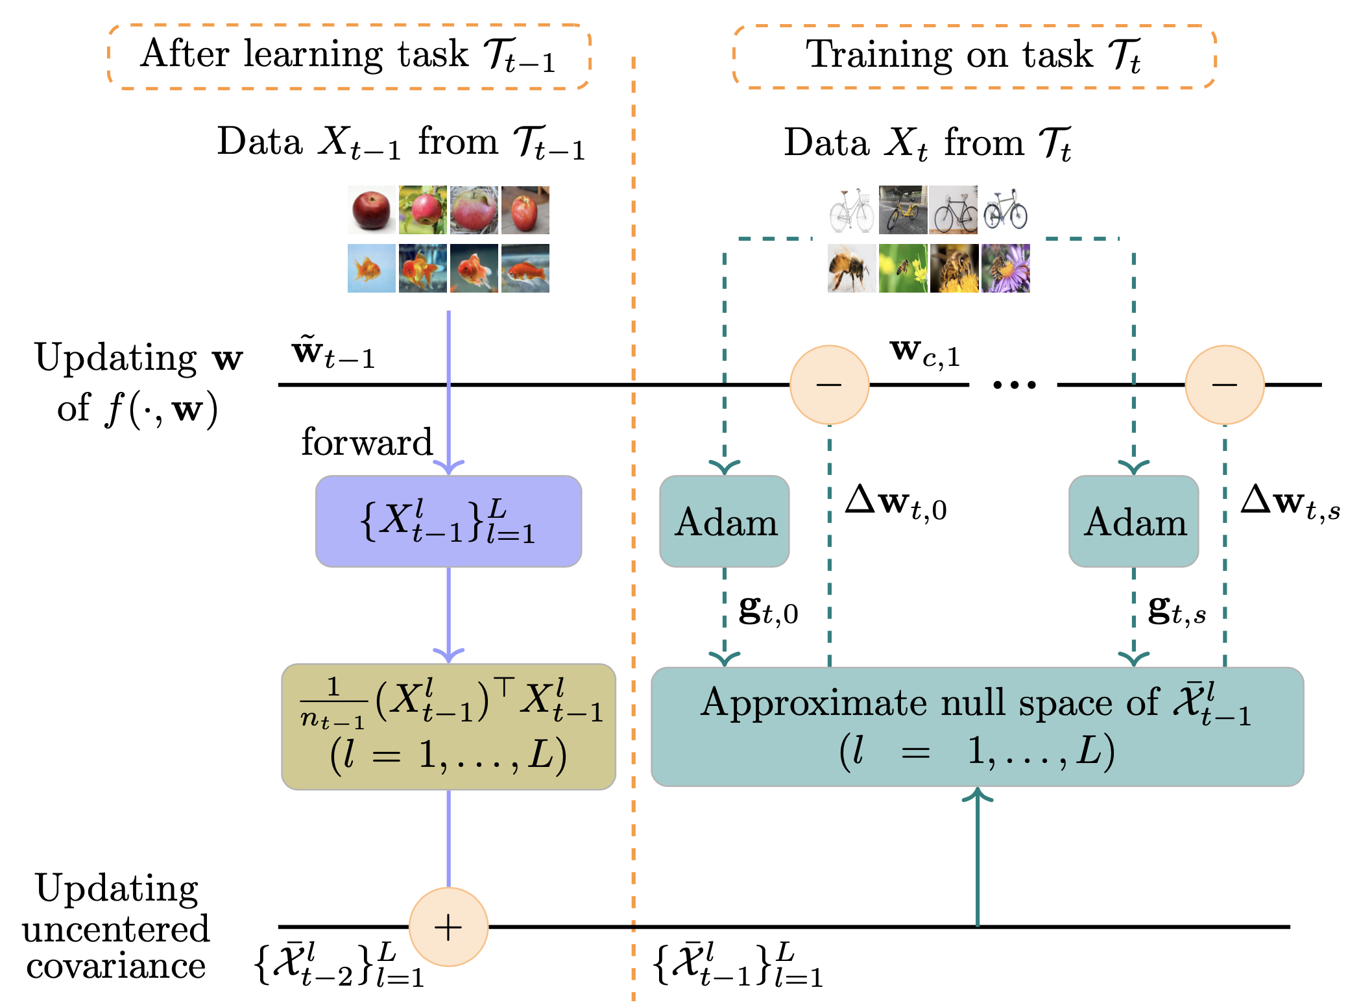
Pipeline of algorithm

Slide 13
Pipeline of algorithm
1️⃣ Incrementally update uncentered covariance
with

Slide 14
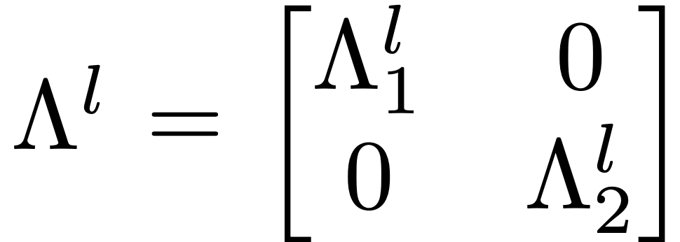
Pipeline of algorithm
1️⃣ Incrementally update uncentered covariance
2️⃣ Approx. null space via SVD.
$𝒩\left({\overline{𝒳}}_{t−1}^{l}\right)$=range space of $U_{2}^{l}$

Slide 15
Pipeline of algorithm
3️⃣ Projection
1️⃣ Incrementally update uncentered covariance
with
2️⃣ Approx. null space via SVD.

Slide 16
Pipeline of algorithm
It can be verified that
i.e., $−Δw_{t,s}$ is the descent direction on current task
3️⃣ Projection
1️⃣ Incrementally update uncentered covariance
2️⃣ Approx. null space via SVD.

Slide 17
PART 03
Experiments
Comparison
Ablation

Slide 18
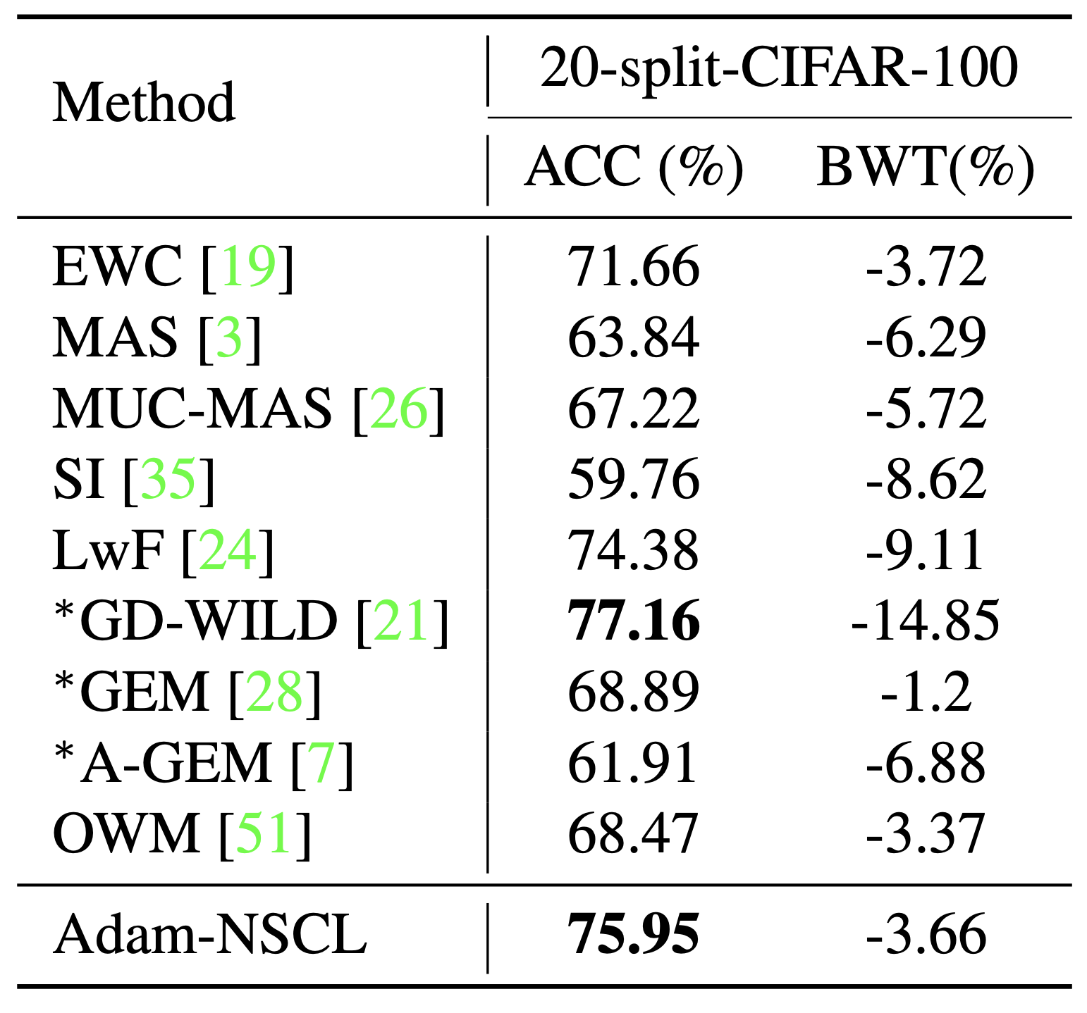
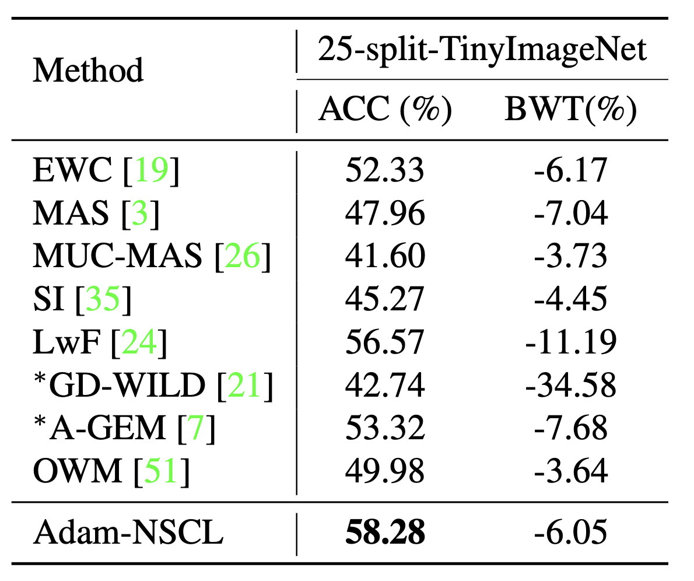
Comparison
Cf. our paper for more details and comparisons.

Slide 19
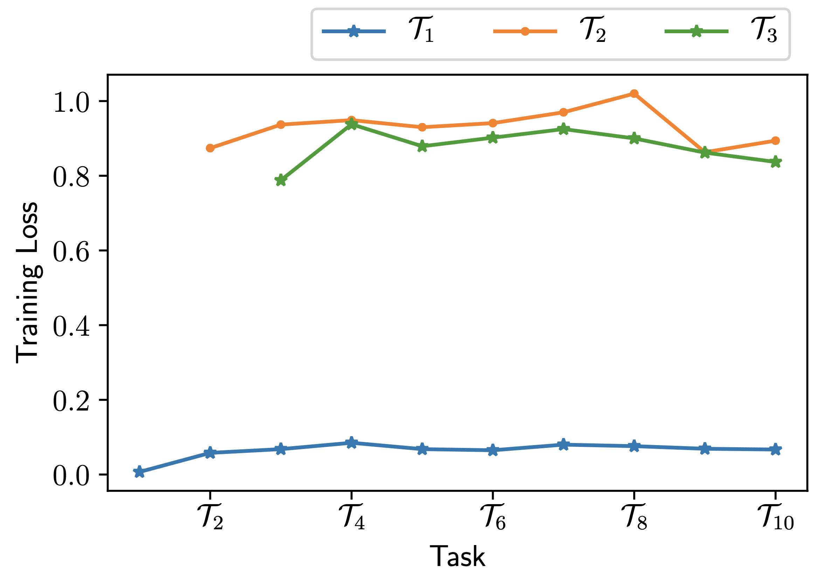
The evolution of loss
Our algorithm is helpful to avoid forgetting

Slide 20
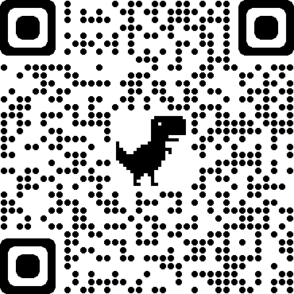
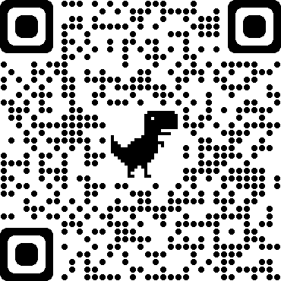
Thanks！

